Slide 1
Tobacco Cessation
Olivia
MSSU Dental Hygiene

Slide 2
Periodontal diseases, including gingivitis and periodontitis, are severe infections, and if left untreated, they can lead to tooth loss. Periodontal disease is a chronic bacterial infection that affects the gum tissue, bone, and attachment fibers that support the teeth and hold them in place in the jaw bone
Smokers who smoked less than a half a pack of cigarettes per day are almost three times more likely than nonsmokers to have periodontitis, according to a study by researchers at the Centers for Disease Control and Prevention in Atlanta, Georgia.

Slide 3

The Warning Signs of Periodontal Disease
If you are a tobacco user, consider if you have the most common symptoms of periodontal disease:
• Bleeding gums during brushing
• Red, swollen, or tender gums
• Gums that have pulled away from the teeth
• Persistent bad breath
• Pus between the teeth and gums
• Loose or separating teeth
• A change in the way your teeth fit together when you bite

Slide 4
Smoking v. Vaping
Consists of | Tobacco rolled in paper and lit up flame. | A battery-powered device with liquid cartridge containing nicotine, solvents and flavors, battery, heating element.
Contains Nicotine? | Yes | Usually, but there are nicotine-free liquids as well.
Addictive? | Yes | Yes, in the case of nicotine liquids.
Tar? | Yes | No
Carbon Monoxide? | Yes | No
Lingering Odor? | Yes | No
Long-Term Health Risks | Nicotine addiction, various forms of cancer, hypertension, early death, birth defect. | Nicotine addiction when using liquids with nicotine. Long-term risks are unknown, but thought to be relatively low.

Slide 5
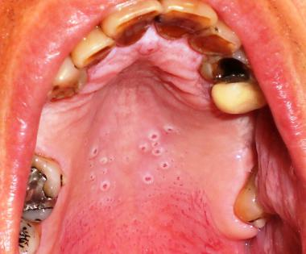
Oral effects of vaping- Nicotine stomatitis

Slide 6
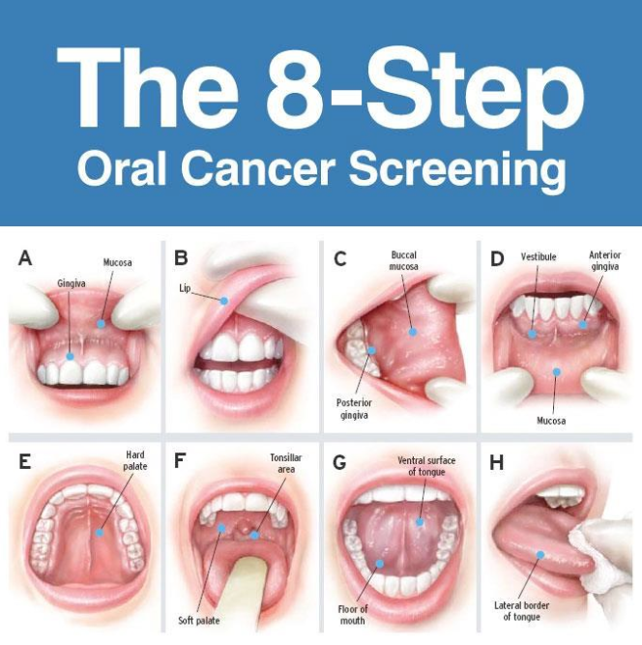

Slide 7
What to look for during oral cancer screening:
White patches
Red patches
Sore that fails to heal and bleeds easily
Abnormal lump or thickening of the tissues
Chronic sore throat
A mass or lump in the neck
Difficulty chewing or swallowing

Slide 8
What you can do
Use a toothpaste containing fluoride, look for the ingredients sodium fluoride.
Lower the frequency.
Visit smokefree.gov
Call 1-800-QUIT-NOW (1-800-784-8669) if you want help quitting.

Slide 9
NRT Types | How to Get Them | How to Use Them
Patch | Over the Counter | Place on the skin Gives a small and steady amount of nicotine
Gum | Over the Counter | Chew to release nicotine Chew until you get a tingling feeling, then place between cheek and gums
Lozenge | Over the Counter | Place in the mouth like hard candy Releases nicotine as it slowly dissolves in the mouth
Inhaler | Prescription | Cartridge attached to a mouthpiece Inhaling through the mouthpiece gives a specific amount of nicotine
Nasal Spray | Prescription | Pump bottle containing nicotine Put into nose and spray

