Slide 1
Prevention of dental caries
Olivia
MSSU Dental Hygiene Department

Slide 2
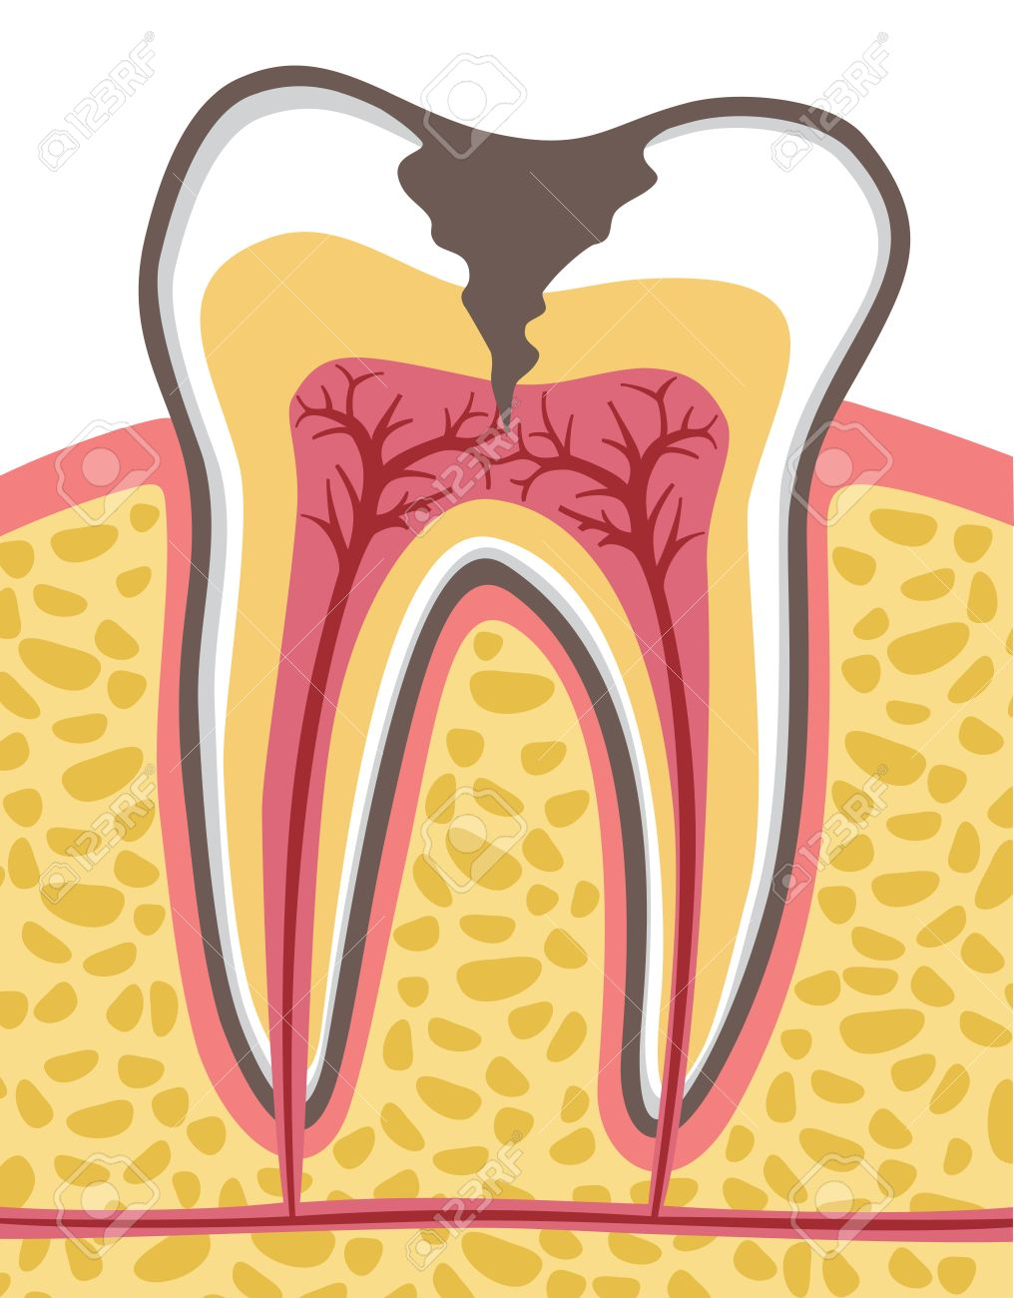
What are dental caries?
Dental caries are another name for tooth decay or cavities.
They are caused by multiple different factors.

Slide 3
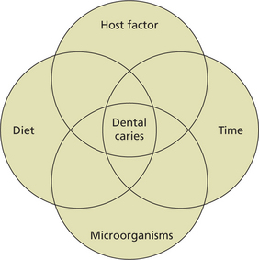
What causes dental caries?

Slide 4
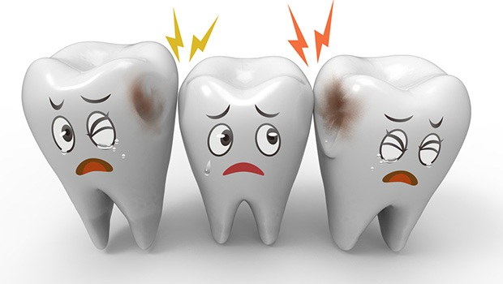
When you don’t take proper care of your teeth by brushing and flossing, specific bacteria clings to your teeth, and if left untreated for too long, causes caries.

Slide 5
diet
Your diet is a large contributor to dental caries.
Some foods are called cariogenic, meaning they lower the pH in your mouth, creating an acidic environment, and cause caries. Another name for these foods are fermentable carbohydrates.
Other foods are anticariogenic, meaning they offer protection to your teeth and reduce the formation of cavities.
Knowing what foods are good and what foods to avoid can help you to prevent the formation of caries.

Slide 6
Recommended foods
Proteins
  Meat, seafood, poultry, eggs, nuts, and seed.
Low-fat milk
Cheese – especially hard cheeses.
Sugar-free chewing gum (xylitol)
Firm fruits and vegetables.
Eating these foods as snacks or at the end of a meal can help you maintain a healthy mouth.

Slide 7
Foods to avoid
(Fermentable carbohydrates)
Avoiding these foods can help you maintain a healthy mouth.
  Alcohol
  Bananas
  Chips
  Cookies
  Flavored coffees and teas
  Honey
Ice cream
Peanut Butter
Snack cakes
Soft drinks
Sport drinks

Slide 8
Frequency
Another thing to keep in mind is the “frequency” of when you eat.
Consider this, you have a can of soda, do you think it would be most beneficial for your teeth to drink it all in one setting or sip on it throughout the day?
  Sipping on it throughout the day has the greatest potential for caries. This is because every time you take a drink the pH in your mouth lowers.
  Bacteria grow in a lower pH, forming acid.
It is recommended to always finish a meal with an anticariogenic food, such as a glass of low-fat milk, to help reduce formation of caries.
  Milk acts as a buffer and raises the pH in your mouth.

Slide 9
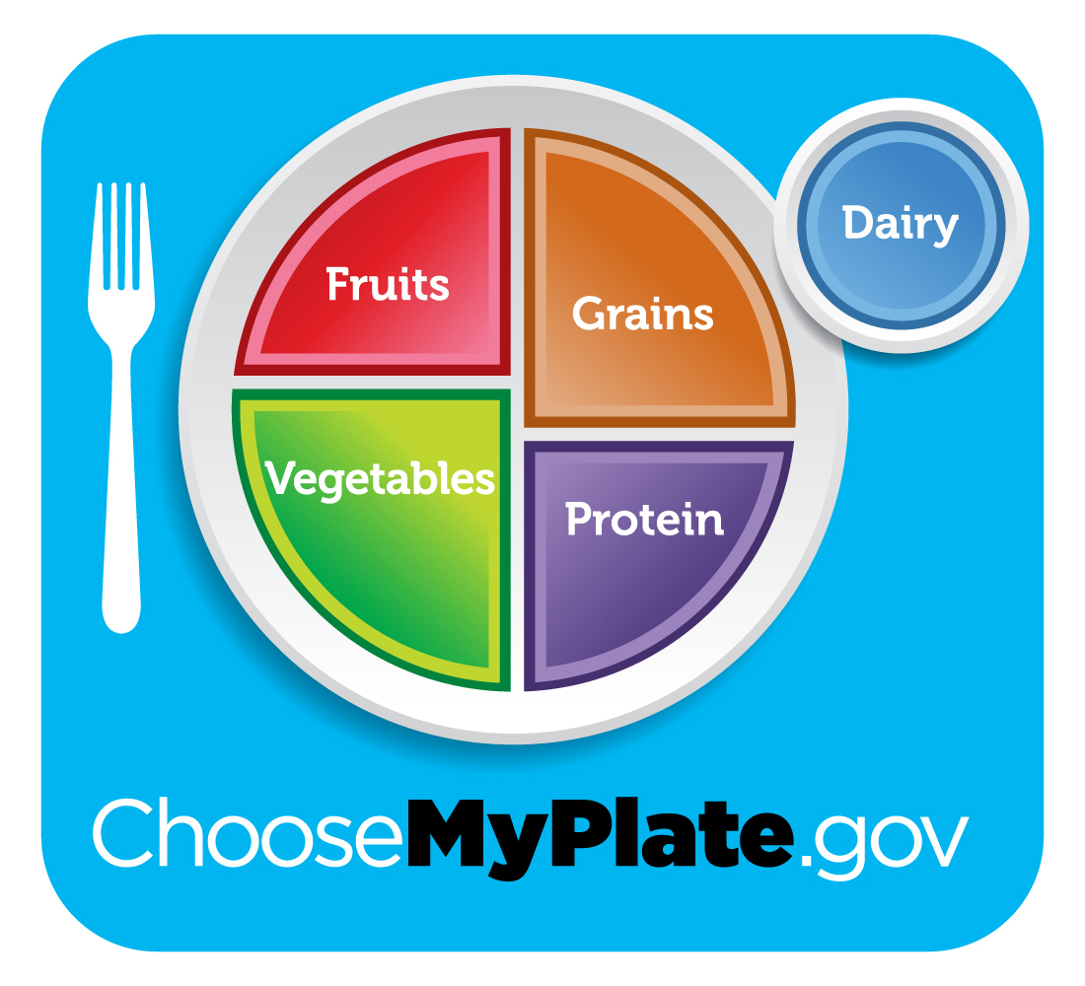
Myplate.gov

Slide 10
Contact information
MSSU Dental Hygiene Clinic
3950 Newman Rd., Joplin, MO 64801
  Located in the Health Science Building
Phone number: 417-625-9711
Email: dentalhygiene@mssu.edu

Slide 11
references
Tooth cross section (anatomy) with dental caries. (n.d.). Retrieved March 26, 2018, from https://www.123rf.com/photo_64676886_stock-vector-tooth-cross-section-anatomy-with-dental-caries.html
Metagenomic Analysis of Biofilm in Dental Plaque. (n.d.). Retrieved March 26, 2018, from http://mmg-233-2014-genetics- genomics.wikia.com/wiki/Metagenomic_Analysis_of_Biofilm_in_Dental_Plaque
Stegeman, C. A., & Davis, J. R. (2015). The dental hygienists guide to nutritional care. (4th ed.) Elsevier Health Sciences. Pg 366, 368.

