Slide 1

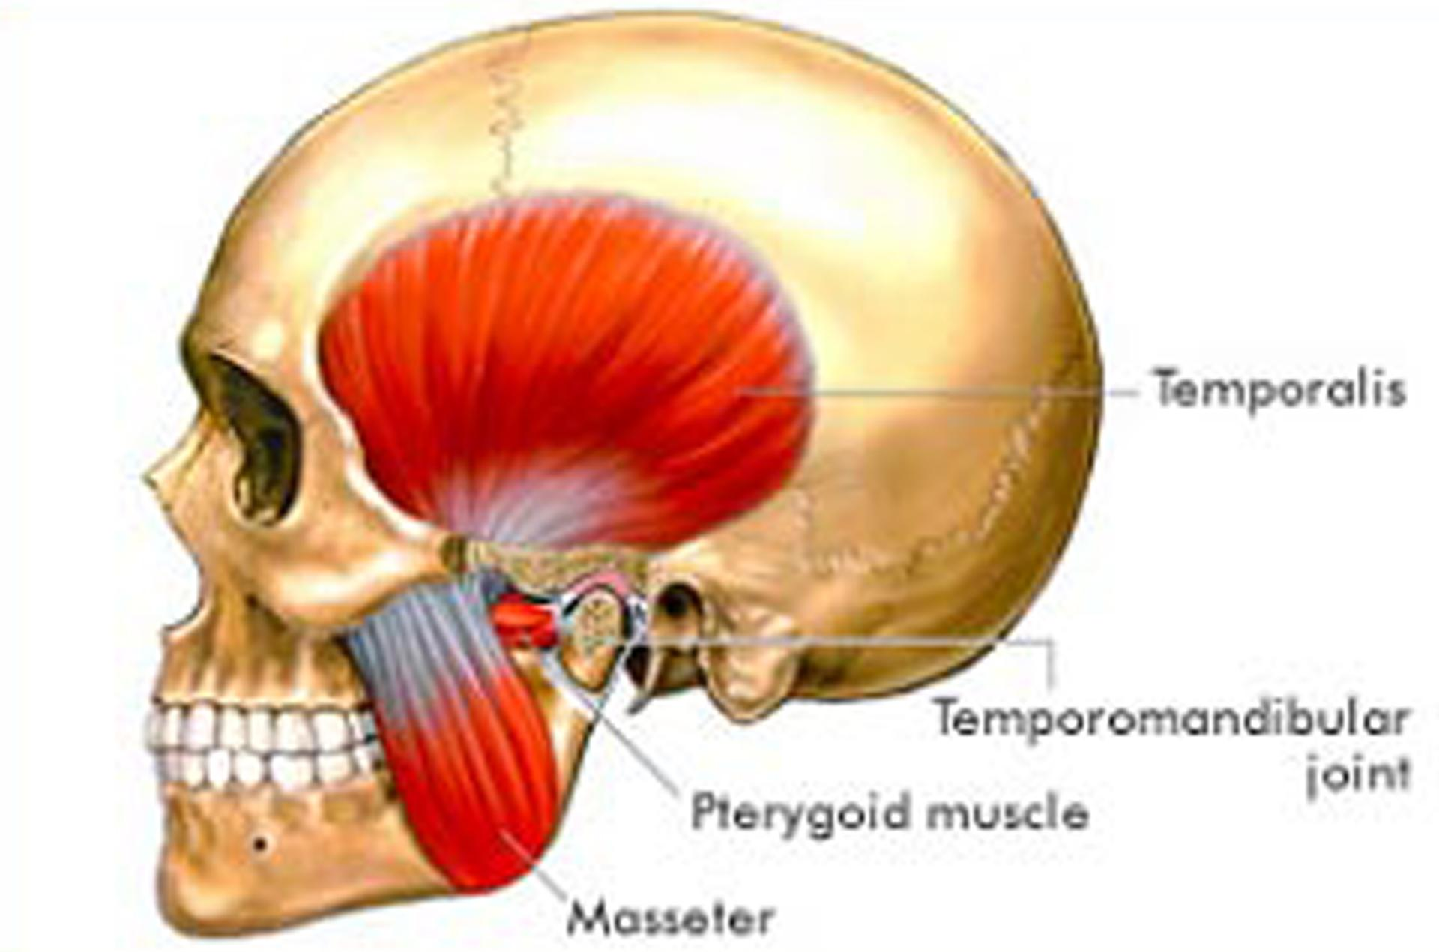
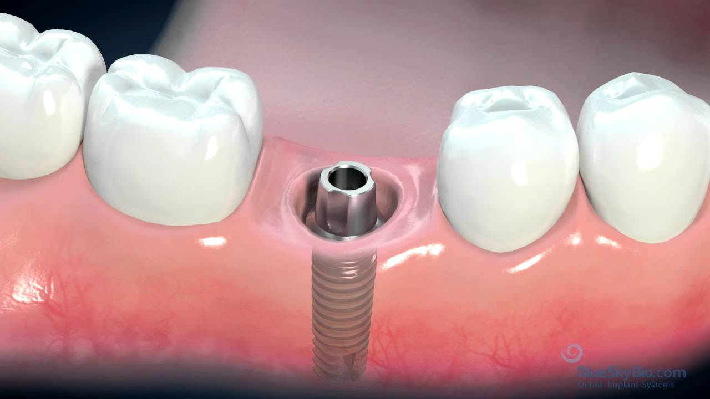
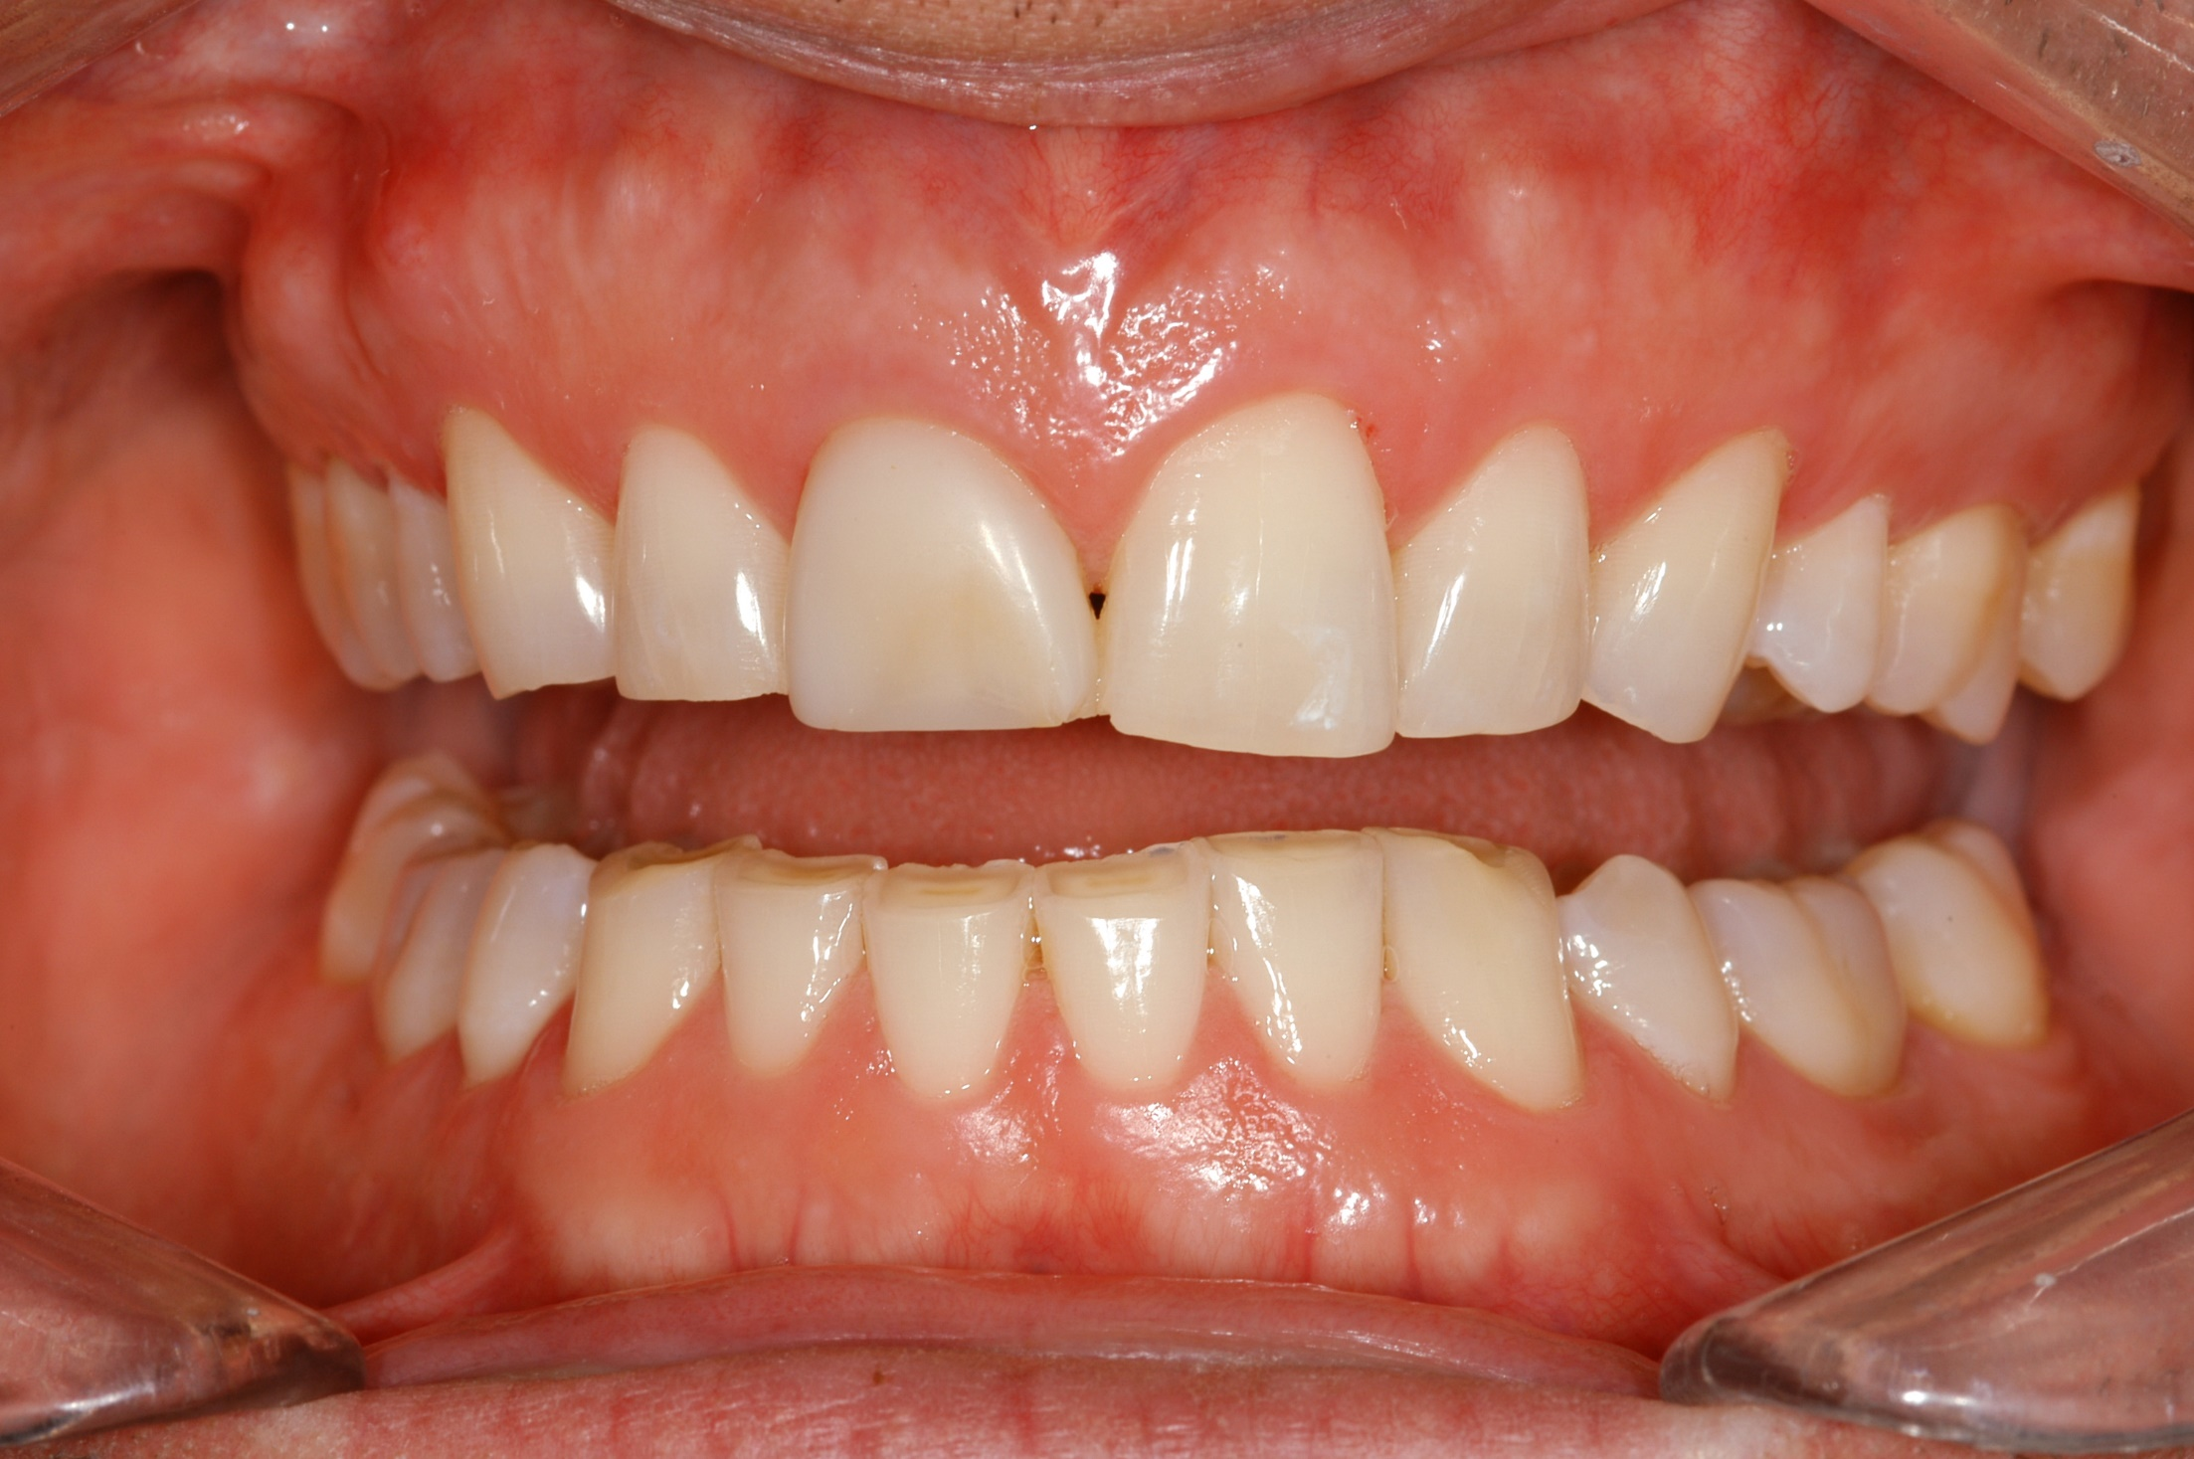
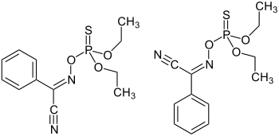
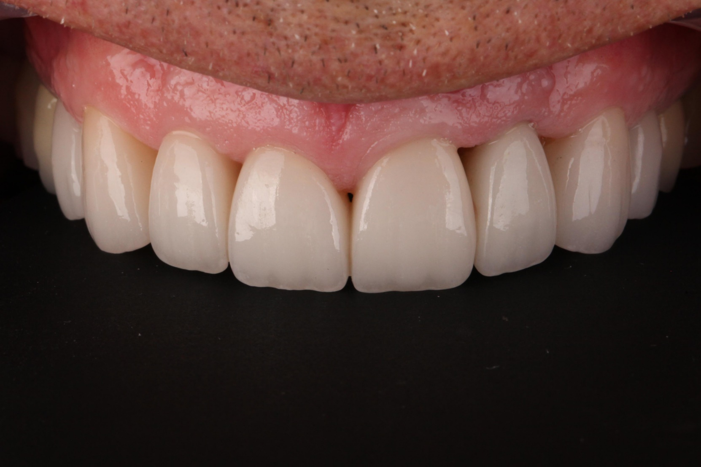
The Beauty of Botox
Botox Use in Dentistry
Jordan Banasik, Olivia Laidler, Alex Kerr
￼
ABSTRACT
Botulinum toxin has been repurposed for the treatment of many dental disorders. It is derived from the bacterium clostridium botulinum (CDC, N.D.). In small doses, its chemical makeup allows it to become beneficial in the medical field. Its therapeutic uses have contributed symptom relief of temporomandibular disorders, dental implant success, black triangles, and bruxism. Although beneficial, Botox has limitations and adverse reactions.
WHAT IS BOTOX
Botulinum toxin is Purified exotoxin of the anaerobic bacteria, clostridium botulinum (Azam, 2015). “Clostridium botulinum, the bacterium from which Botox is derived, is found in many natural settings, including soil, lakes, and forests” (Nichols, 2017). There are seven types of botulinum toxin that have been isolated, types A-G (Azam, 2015). Out of the seven the two toxins used and available to the public are types A and B. Botox can be available “as Botox, Dysport, or Xeomin”(Blessing, 2017). Each specific toxin has a method of action within the body and serves a function and purpose.
METHODS FOR USE IN DENTISTRY
TEMPOROMANDIBULAR DISORDER
BRUXISM
DENTAL IMPLANTS
BLACK TRIANGLES
PROMINENT GUMS
MASSETERIC HYPERTROPHY
MANDIBULAR SPAMS
SIALORRHEA
DENTAL IMPLANTS
Osseointegration, the structural and functional connection of living bone and an implant (Parithimarkalaignan, 2013), of dental implants can increase by using Botox to relax the masticatory muscles relieving the implant and encouraging osseointegration (Srivastava, 2015).
Forces from hyperactive masticatory muscles can also prevent or impede fracture callus formation after maxillofacial fracture fixation.
In both conditions muscular relaxation can be achieved with BT injections into the masticatory muscles allowing a more stable environment for implant integration and fracture healing (Nayyar, 2016).
BRUXISM
-
Bruxism is a condition in which you grind, gnash or clench your teeth. (Bruxism).
Sign and symptoms include “tooth wear, periodontal disease, headaches, TMJ disorders”(Govindaraju, 2015).
Some effects of bruxism are a severe rate of attrition, wear facets, hypertrophy of masticatory muscles, cheek biting, tooth mobility and pulpal sensitivity (Ibsen, 2018).
Treatment includes “BT injection to the masseter muscles”(Govindaraju, 2015).
-
http://www.ildentistamoderno.com/implantologia-informazioni-paziente/
http://huttohippofamilydental.com/wp-content/uploads/2016/07/tmj.jpg
BLACK TRIANGLES
Black triangles are spaces in between the teeth with missing gingiva. Normally the gingiva comes to a point forming triangles in between the teeth.
The loss of papilla can lead to cosmetic deformities, phonetic, and lateral food impaction. Often the loss of papilla is a consequence of periodontal disease because of gingival inflammation, attachment loss and interproximal bone height resorption (Nayak, 2013).
“Injecting BT into theses areas it literally plumps up papilla and is a minimally invasive way to create proper and more pleasing gingival contours”(Govindaraju, 2015).
http://www.defactodentists.com/blog/wp-content/uploads/2016/07/Bruxism-image.jpg
TEMPOROMANDIUBLAR DISORDER
Temporomandibular joint disorders, or TMD, can be defined by “a number of diseases affecting masticatory function, which may include true pathology of the temporomandibular joint as well as masticatory muscle dysfunction” (Naayar, 2014).
Patients with temporomandibular joint disorder often experience a “clicking, popping, grinding, and discomfort upon opening, closing or mastication” (Wilkins, 2017).
The administration of Botox into temporalis and masseter muscles has shown to improve ability of the mouth opening and reduce pain (Srivastava, 2015).
LIMITATIONS AND CONTRAINDICATIONS
      Respiratory disorders
Dysphagia disorders
Avoid administering Botox to a site where an infection is present
Allergy to Botox
ADVERSE REACTIONS
Headache
Dizziness
Infection
Pruitus
Muscle weakness
https://www.thelancet.com/journals/lancet/article/PIIS0140-6736(10)60323-6/fulltext?version=printerFriendly&code=lancet-site
HOW DOES IT WORK
The mechanism of action of botulinum toxin is as follows: “Intramuscular administration of botulinum toxin acts at the neuromuscular junction to cause muscle paralysis by inhibiting the release of acetylcholine from presynaptic motor neurons” (Nigam, 2010), resulting in flaccid paralysis.
CONCLUSION
In conclusion, Botox in dentistry offers so many therapeutic actions to patients who struggle with issues that are hard to treat. Administering the botulinum toxin helps to relax muscles, thus treating multiple disorders and conditions. Although there are some contraindications and adverse effects the positive often outweighs the negative. The adverse effects are generally transient and resolve within a couple of weeks (Govindaraju, 2015).
https://clinicalmastery.com/treating-black-triangles/
Notes:
A. Introduction
1. Introduce the topic
2. Establish a mood or climate
3. Motivate and interest the audience
4. Establish a common knowledge base
5. State the objectives for the presentation
B. Body of the presentation
1. Present the major points
-TMD
-Dental Implants
-Gummy smile
2. Insert examples of supplementary materials
3. Use questioning to get the audience involved
4. Cite literature & supporting documentation when appropriate
C. Closure
1. Review or summarize the main points
2. Relate to your introduction for cohesion

