Slide 1
John Doe
Eaglesoft ID #10159
Oral Case Study 2018
Olivia Laidler

Slide 2
General Characteristics
Mr. Doe is a 51 year old, Caucasian male.
Patient’s chief complaint is wanting to maintain healthy tooth structure and bone levels.

Slide 3
Social History
Mr. Doe is single, lives alone and has no children.
Work: Mr. Doe is a factory worker.
Education: Mr. Doe has a high school diploma.

Slide 4
Dental History
Symptoms: No symptoms patient observed or stated.
Mr. Doe’s last dental visit was 5 years ago at Dr. Ringers office in Joplin, MO.
His last radiographs were taken in September 2018 at the Missouri Southern Dental Hygiene Clinic.

Slide 5
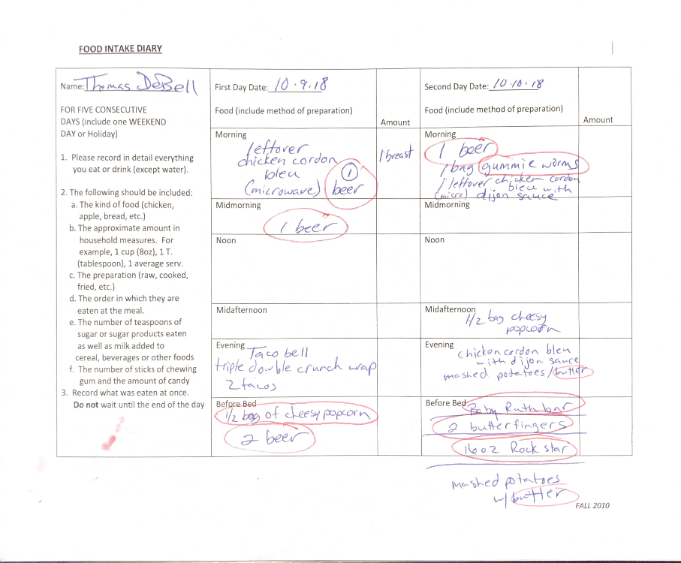
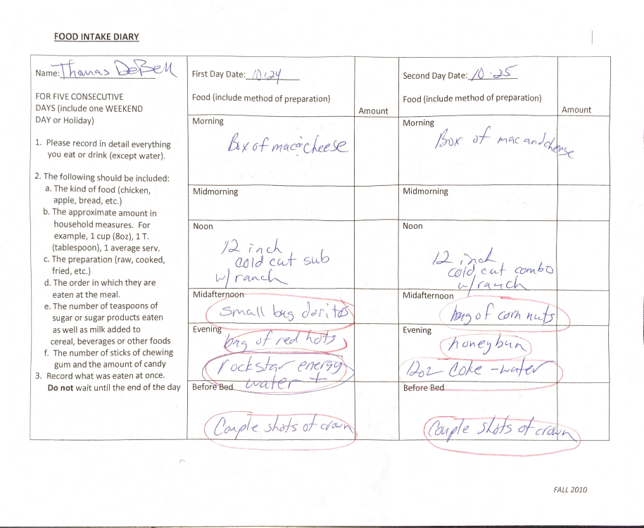
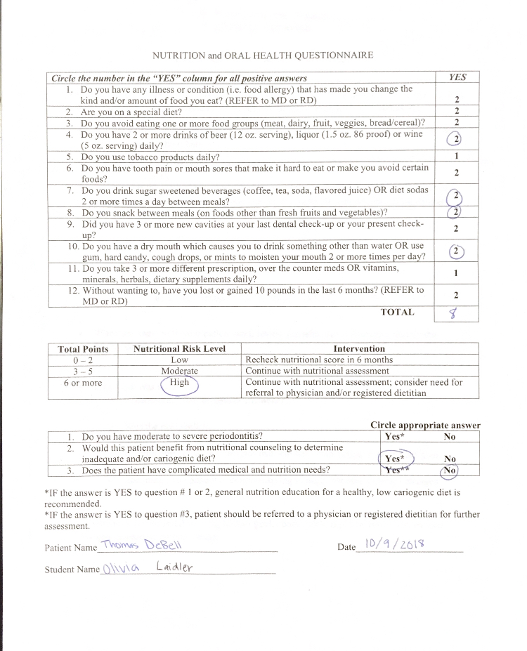
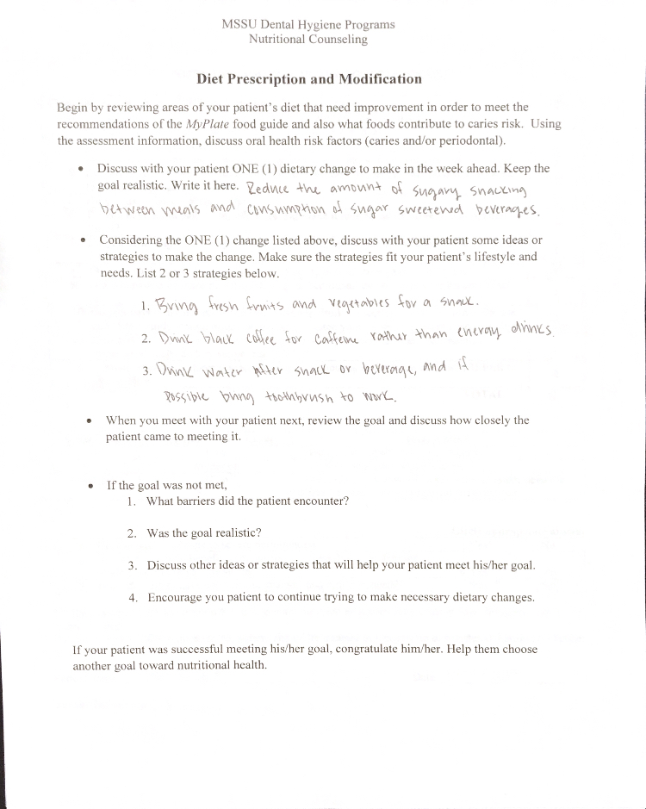
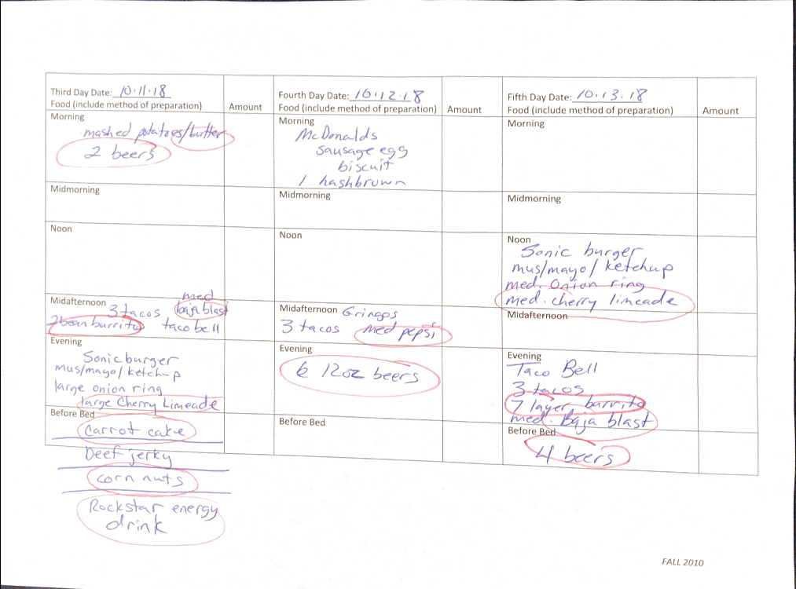
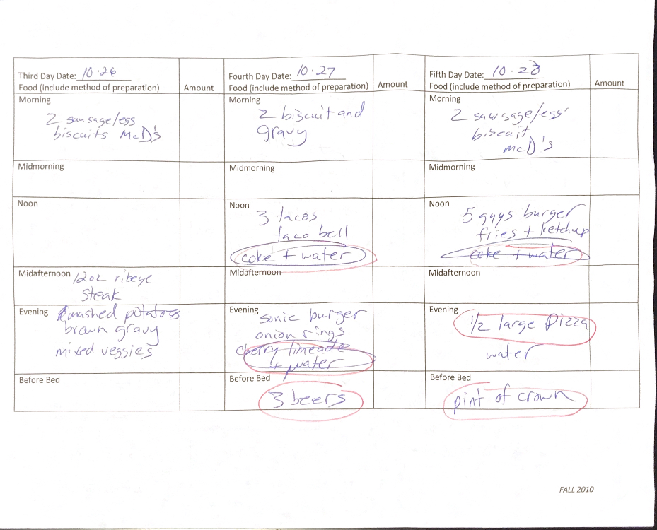
Nutritional Counseling

Slide 6
Patients Attitude Toward Counseling
During the counseling session, Mr. Doe was willing to make changes to better his overall health. He stated that he had a past history of “not making the best health decisions” and was ready to improve his lifestyle.
Although Mr. Doe did not fully eliminate the anticariogenic foods from his diet, he at least made the addition of water, and reduced the frequency tremendously.
During the sessions Mr. Doe asked me various questions on how he could improve his diet, he was also interested in seeing his x-rays and being informed on his periodontal condition.

Slide 7
Patient History
Mr. Doe experienced a concussion in 1990 due to getting kicked in the head.
Hospitalized in 1985 due to getting stabbed in the neck, leading to a tied jugular vein.
Hospitalized in 2010 after amputating his finger with a skill saw, his finger was sutured.

Slide 8
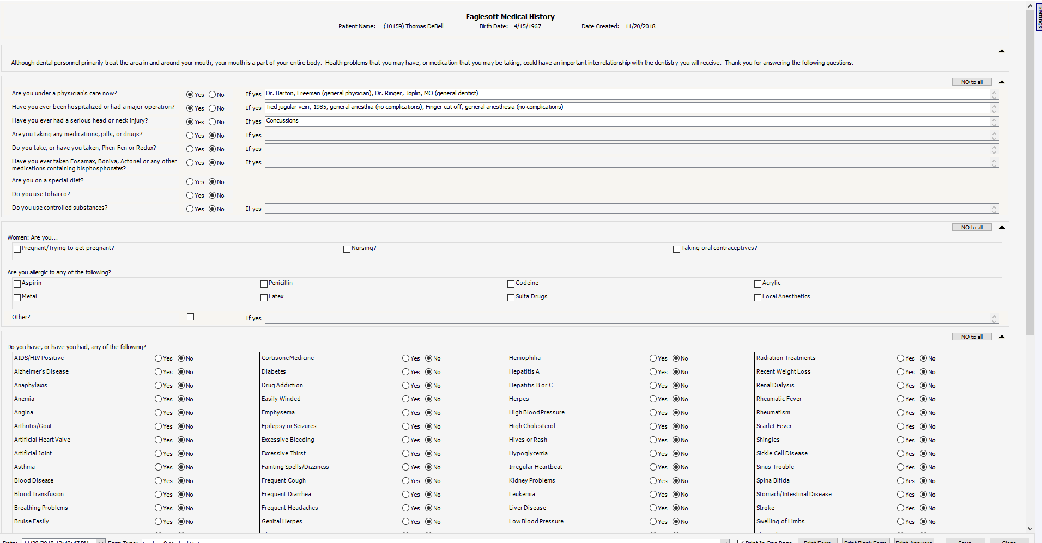
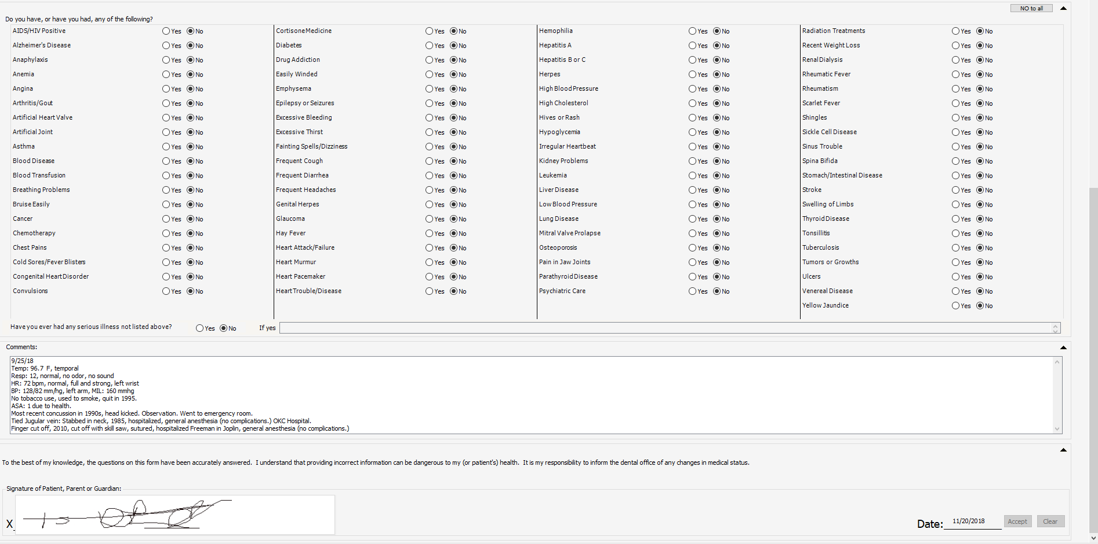
Medical History Form

Slide 9
Patient Vitals
Blood Pressure = 128/84 mmHg. MIL: 160 mmHg.
Pulse = 68 BPM, normal, full and strong.
Respirations = 12 RPM, normal, no odor, no sound.
Temperature = 97.9 F
ASA 1 due to health.

Slide 10
Medical History
Mr. Doe does not go to his physician regularly, and is currently not taking any medications.
No allergies.
Tobacco Use: Mr. Doe does not use tobacco.
Alcohol Use: Mr. Doe drinks more than 3 times a week.

Slide 11
Extra Oral Findings
Left submandibular lymph node was palpable, non tender, mobile.
3x3 freckle located on left side of face.
3x3 red dot located on left side of nose.

Slide 12
Intra Oral Findings
Mr. Doe has maxillary tori, and fordyce granules located on upper and lower lips.
Generalized severe attrition.
Generalized moderate intrinsic yellow staining.
Chip on the mesial incisal of tooth 7.
Missing teeth 13 and 14.

Slide 13
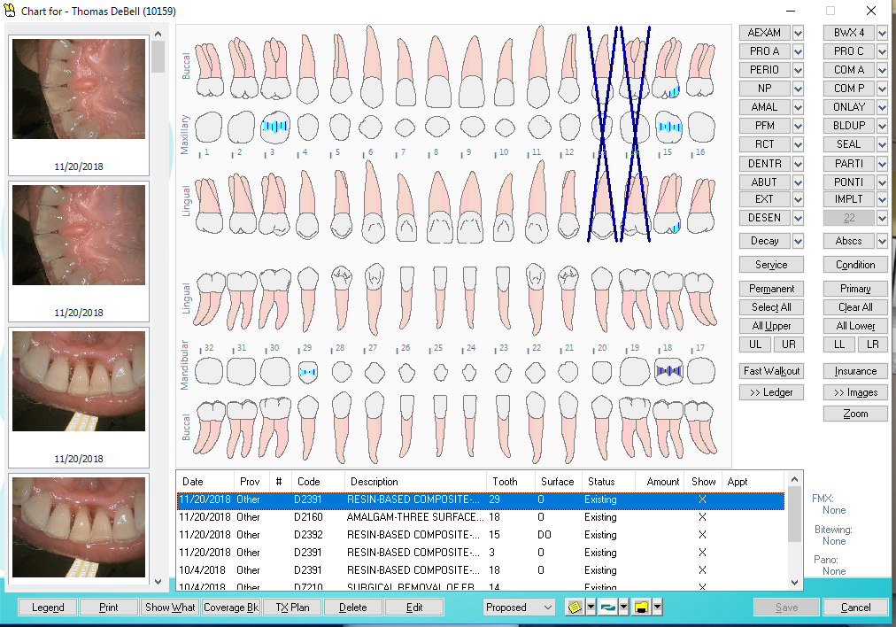
Dental Chart

Slide 14
Occlusion
Mr. Doe has Class 1 occlusion.
A 2 mm over jet.
Midline is shifted right 1 mm.
Mild overbite.

Slide 15
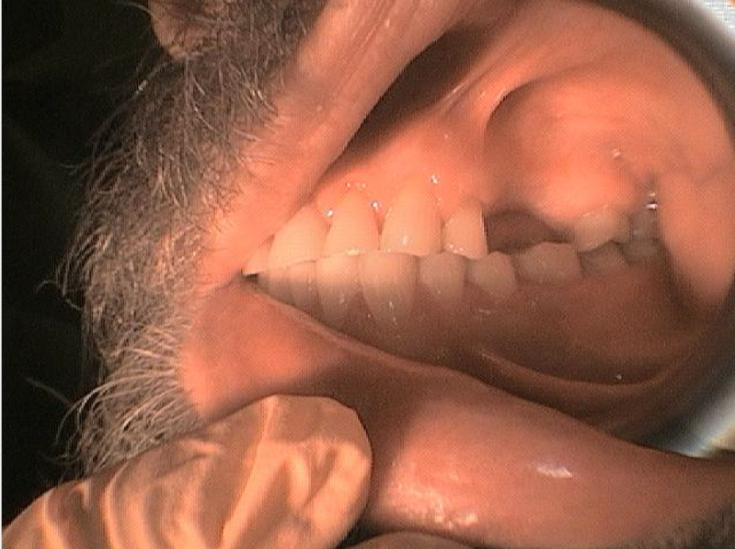
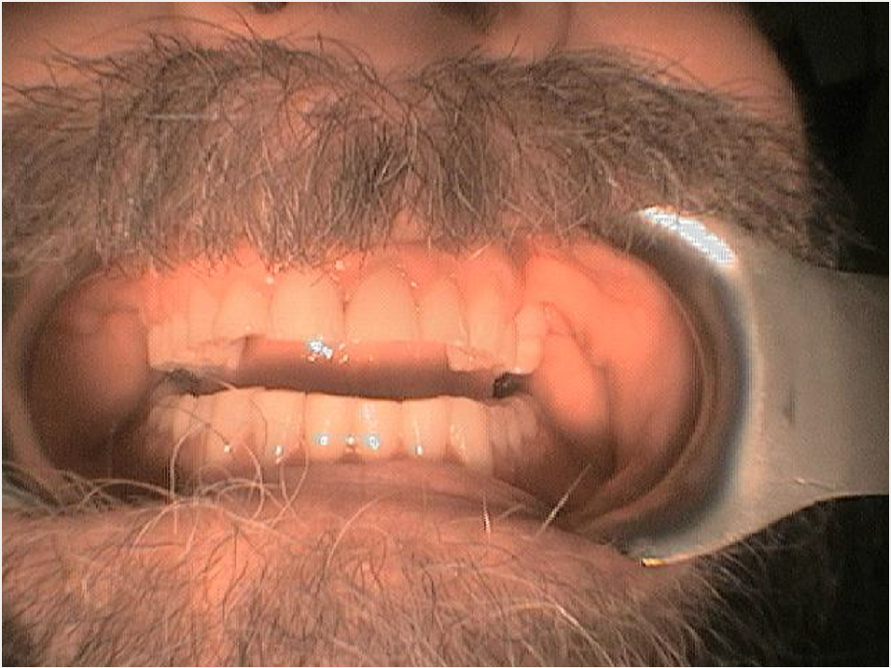
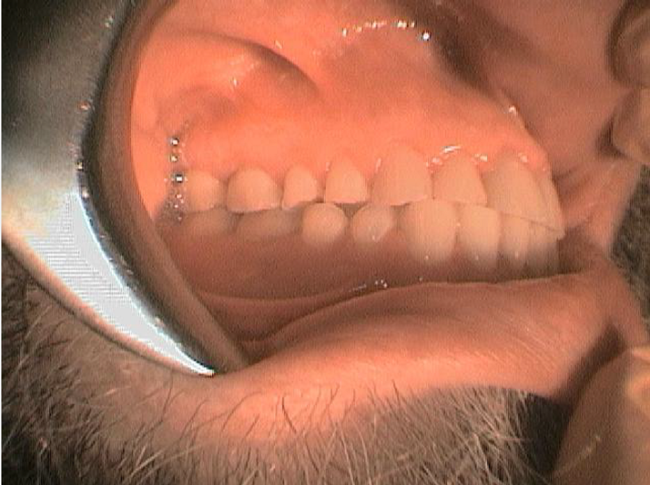
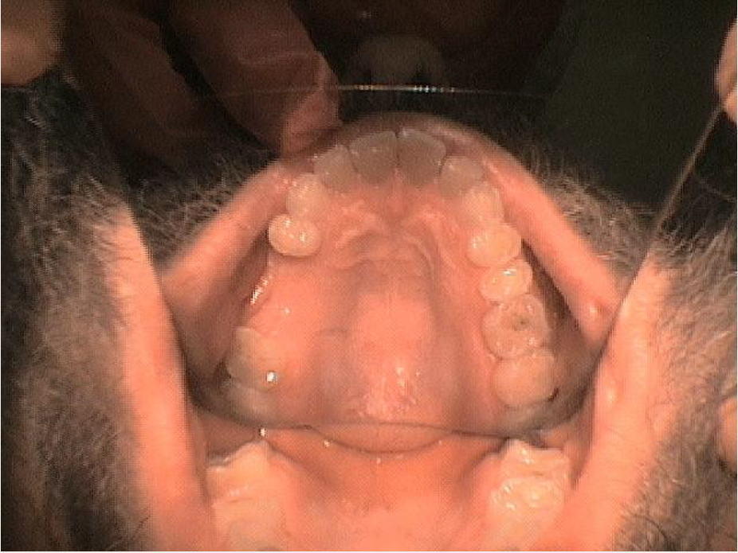
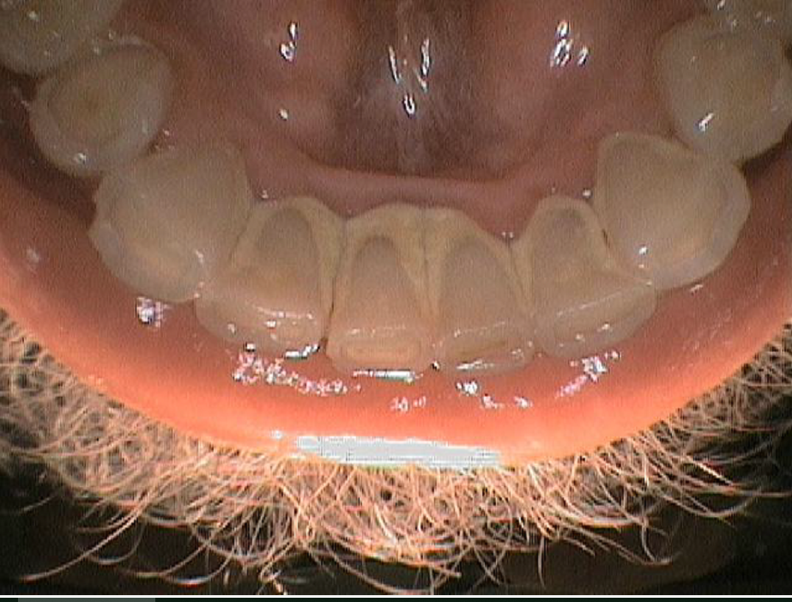

Slide 16
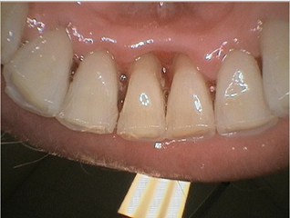
10/04/2018 – Before
11/20/2018- After

Slide 17
Caries Risk Assessment
  Environmental Influences
    Mr. Doe works evenings and tends to not cook for himself for that reason. He stated that it is more convenient grabbing food to go, and because of that it is affecting his oral health.
  Access to dental care
    Mr. Doe owns a vehicle.
  Fluoridated water
    Mr. Doe stated he currently drinks fluoridated water and did as a child.

Slide 18
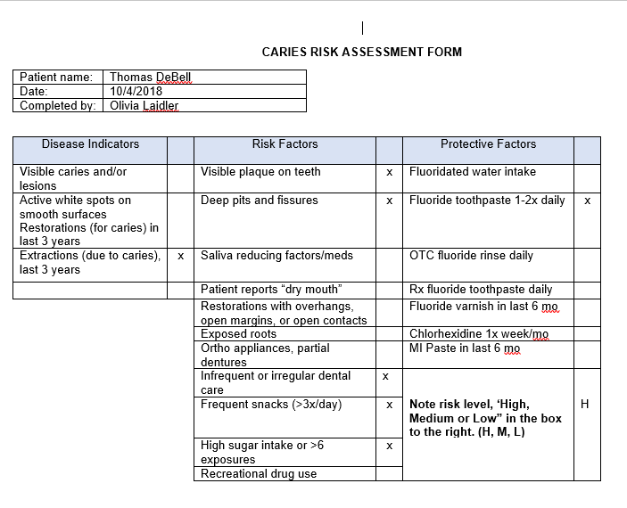
Caries Risk Assessment

Slide 19
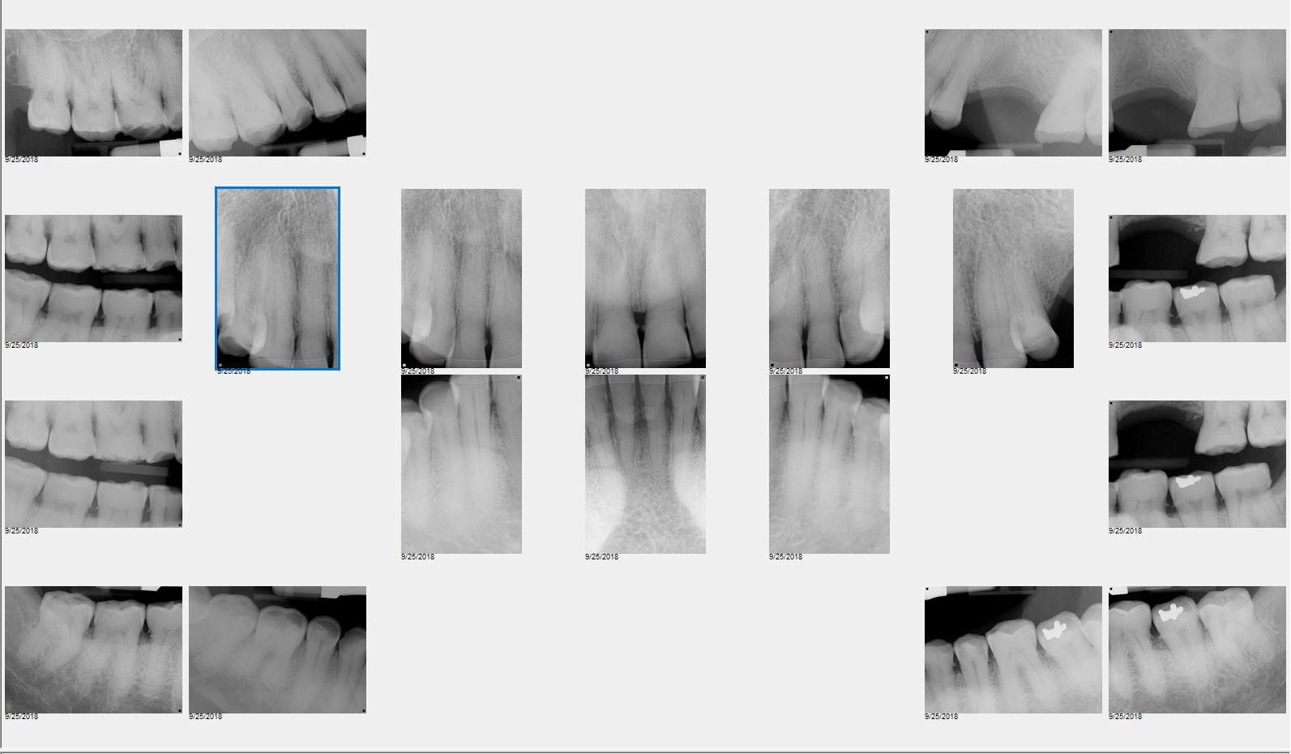
Radiographs – 4 Horizontal Bitewings

Slide 20
Radiographs - 20 Full Mouth Series

Slide 21
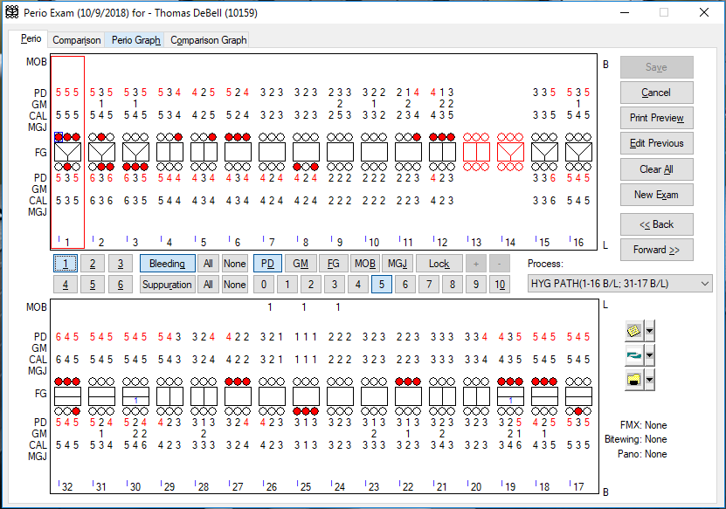
Periodontal Chart

Slide 22
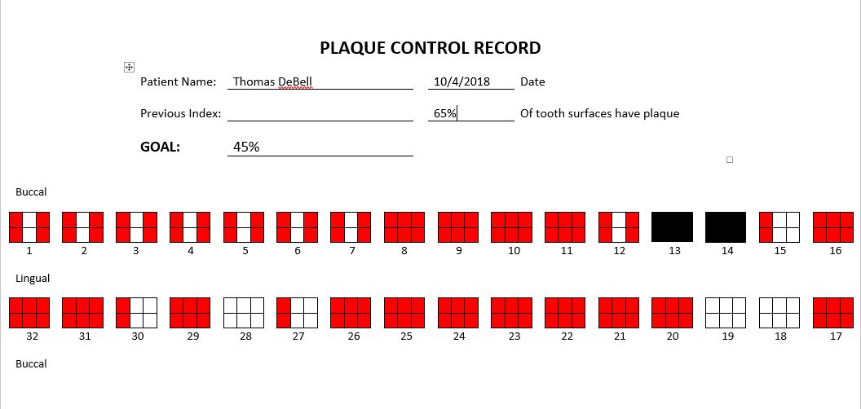
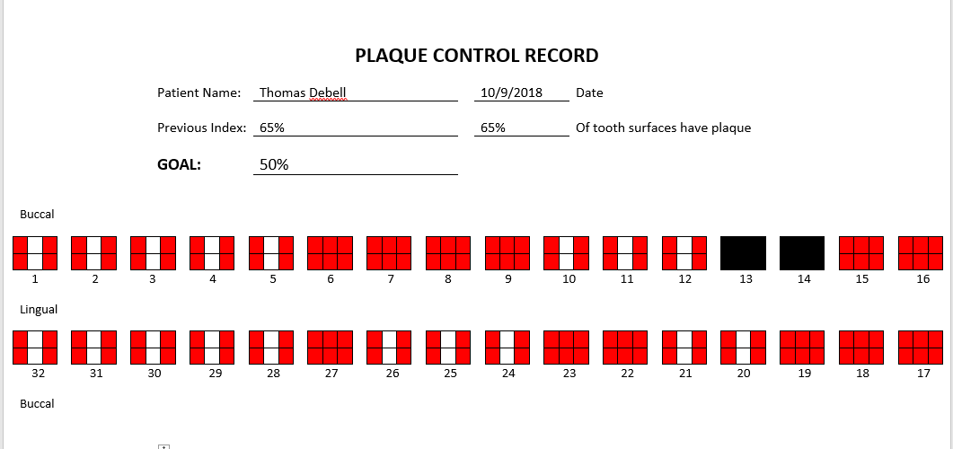
Plaque Index
After Mr. Doe’s first plaque index it revealed he was considered heavy and had poor oral home care. I introduced an electric toothbrush to him and taught him the bass method. I also gave him floss picks to take home.
After his second plaque index it appeared he did not change his home care. At this point I reinforced the bass method, and the importance of brushing and flossing twice daily. I also mentioned bringing a toothbrush with him to work to brush after he eats

Slide 23
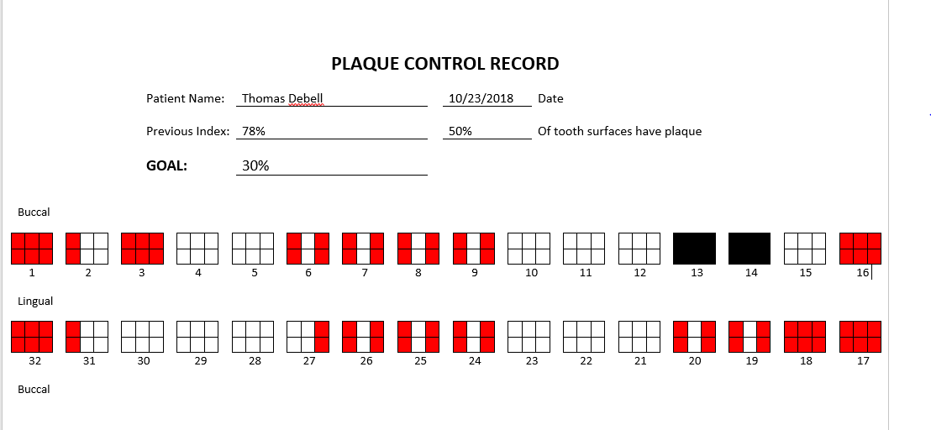
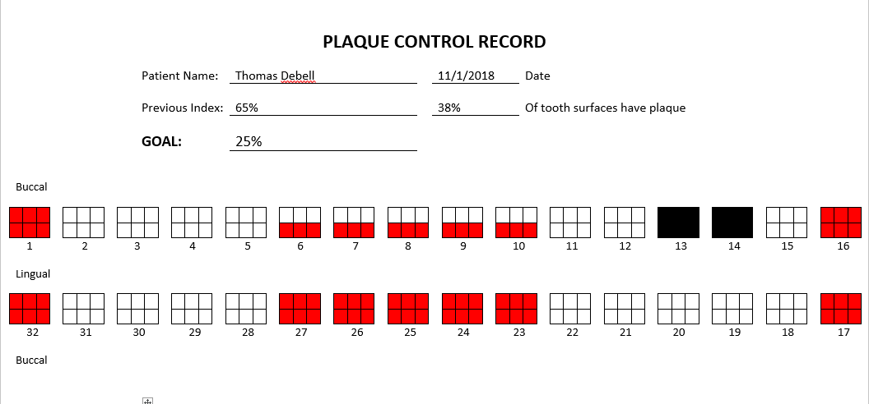
After Mr. Doe’s third plaque index it was evident he still was not changing his home care. I once again explained the importance of good oral hygiene.
After his fourth plaque index he made an even bigger improvement. At this point I could tell Mr. Doe was motivated to continue to improve his oral health.
65%
65%
50%

Slide 24
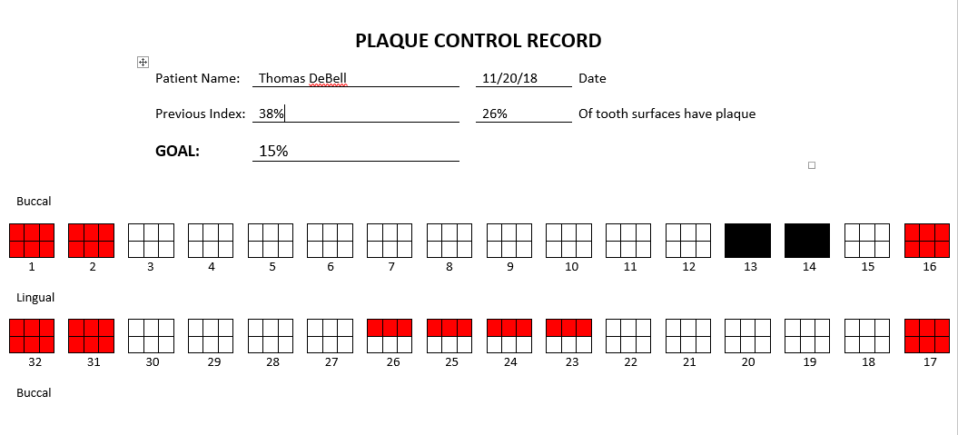
Mr. Doe’s fifth plaque index was the lowest percentage yet. He was now considered light plaque, and remained motivated to bettering his oral health.

Slide 25
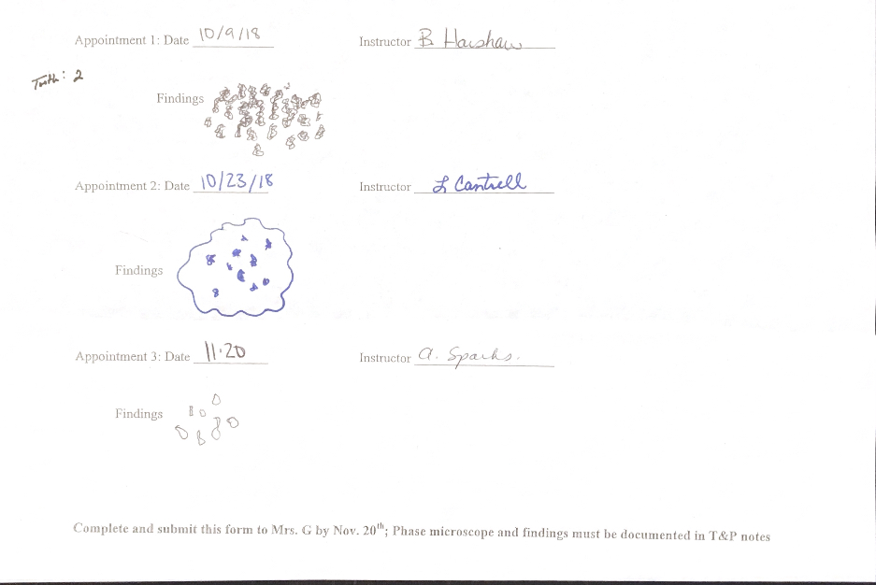
Phase Microscope

Slide 26
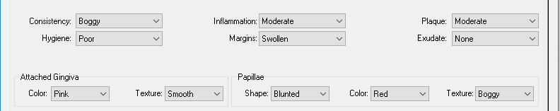
Periodontal Diagnosis
Generalized moderate marginal inflammation with BOP.
AAP 2.
Mr. Doe was periodontal level 3 in all quadrants.

Slide 27
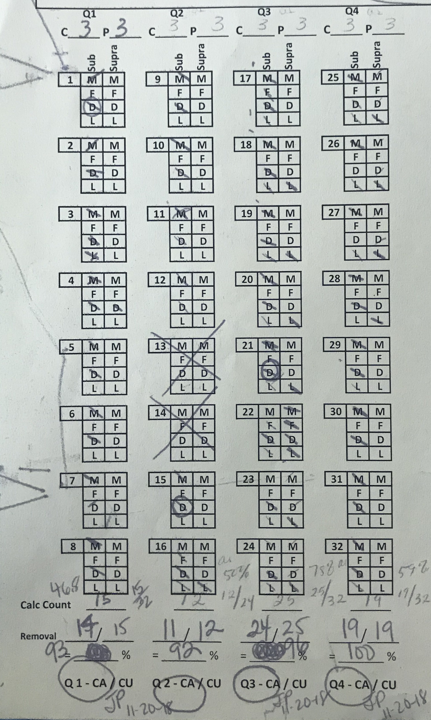
Deposit Assessment
Mr. Doe was calculus level 3 in all quads.

Slide 28
Economic Influences
Socioeconomic status can be assessed by the patients ability to resources, based on income, education, and occupation.
  Mr. Doe’s socioeconomic status is working class.
Dental insurance: Mr. Doe does not have dental insurance.

Slide 29
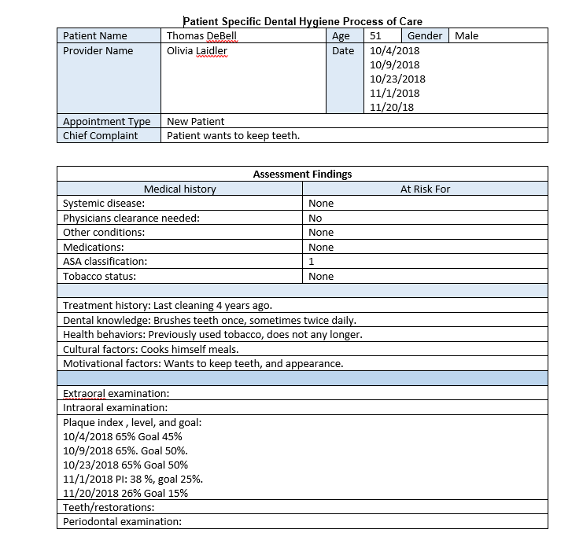
Process of Care

Slide 30
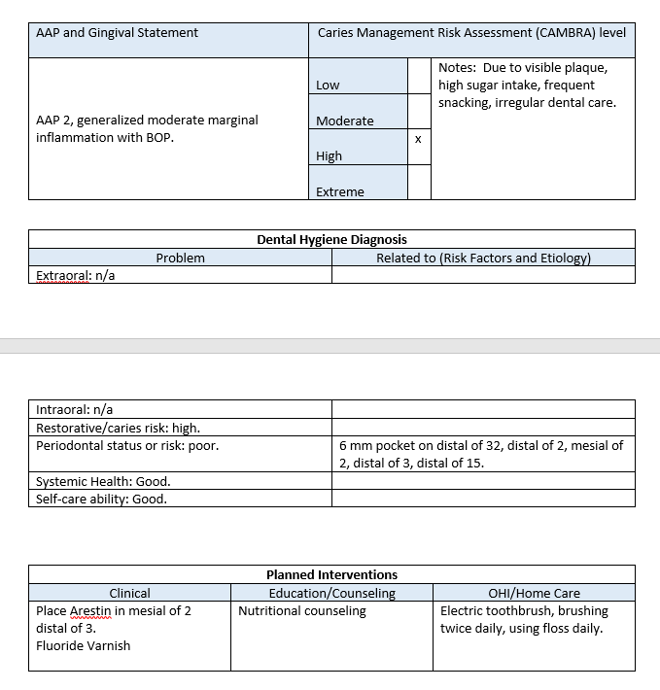

Slide 31
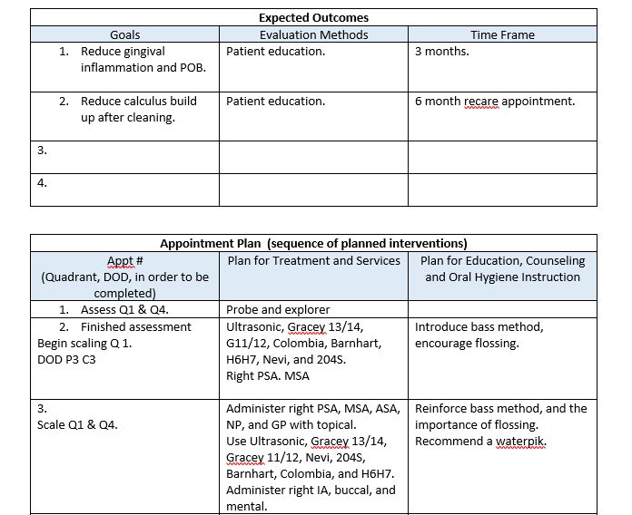

Slide 32
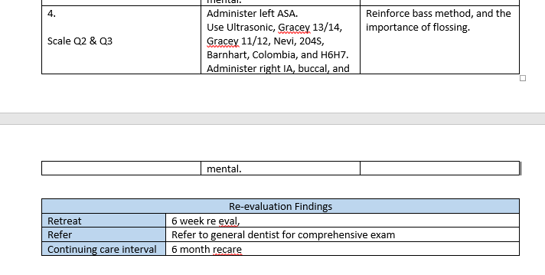

Slide 33
Treatment Plan
Mr. Doe came to six, three hour appointments.
During the first appointment, I completed an EOIO assessed quadrants 1 and 4.
  DOD: Q1: C3 P3 Q4: P3 C3
Second appointment, completed assessing quadrants 2 and 3.
  DOD: Q2: C3 P3 Q3: C3 P3
  Took microscope sample.
  Took intraoral photos.
Third appointment, began scaling quadrant 1.
  Administered right PSA and MSA.
  Completed Nutritional Counseling session.
  Used a blended approach with the ultrasonic and hand scalers.
  Gave patient post op instructions to rinse with warm salt water if needed.
  Took microscope sample.

Slide 34
Fourth appointment, continued scaling quadrant 1.
  Administered right PSA, MSA, ASA, NP, and GP.
  Used a blended approach with the ultrasonic and hand scalers.
Fifth appointment, completed scaling quadrant 1 and quadrant 4.
  Administered IA, long buccal, mental, and infiltration on #25.
  Used a blended approach with the ultrasonic and hand scalers.
  Gave patient post op instructions to rinse with warm salt water if needed.
Sixth appointment, completed scaling quadrants 2 and 3, placed Arestin, polished, and applied fluoride.
  Administered IA, long buccal, mental, and left PSA, MSA, and ASA.
  Used a blended approach with the ultrasonic and hand scalers.
  Gave patient post op instructions to rinse with warm salt water if needed.
  Took microscope sample.
  Took intraoral photos.

Slide 35
Patients Response
Mr. Doe’s response and overall attitude to treatment was wonderful. I don’t think I could have asked for a better case study patient. He was very encouraging during his treatments, and continually asked questions throughout the appointments.
Upon initially meeting Mr. Doe, he immediately had an outgoing personality. However, I could tell he had minor anxiety toward treatment due to noticing “white knuckle syndrome” whenever I would get an instrument close to him.
After his third appointment he was completely calm and inviting to any treatment.
This made me feel more comfortable treating him knowing that there was patient-clinician trust built.
Once I completed Mr. Doe’s cleaning, he stated he was excited to return for his 6-week re eval and show me that he kept up with his oral hygiene.

Slide 36
Motivation technique
Esteem is the motivational technique used. Mr. Doe had not been to the dentist in years and was conscious of his physical appearance.
His confidence began increasing after each appointment.

Slide 37
Goal
Together, Mr. Doe and I made a goal for him to begin flossing daily and brushing twice daily.
It was also our goal to reduce his plaque index percentage.
From the nutritional counseling, Mr. Doe stated he will continue to drink more water and rinse his mouth with water after sugar exposure.

Slide 38
Patient Education
While educating Mr. Doe I found it useful to explain oral health in terms he could understand. I explained to him that plaque is like the slime layer on a fish tank.
I explained to him that calculus are like small rocks, and when I removed his lingual bridge he was able to feel what the calculus felt like.
I presented Mr. Doe his x-rays, periodontal chart, different photos and models of healthy bone level vs. not healthy, and his before and after intraoral photographs.

Slide 39
Dental Hygiene Treatment
Due to Mr. Doe’s periodontal level and calculus level, I had to scale and root plan on all quadrants.
Because I was scaling and root planning in 5+ mm pockets, anesthesia was necessary.
Nutritional counseling was necessary for Mr. Doe because his diet was greatly affecting his dental health.
I completed the plaque index to educate Mr. Doe on where he needs to focus on brushing more adequately.

Slide 40
Follow-up evaluation
Unfortunately, Mr. Doe was unable to come back in for a follow- up evaluation.
However, whenever his cleaning last semester was finished we went over oral hygiene instructions and recommendations to maintain his oral health.
Even after each appointment of SRP in the fall I began to see improvements to his periodontium.

Slide 41
The main goal we had made together was to incorporate flossing and brushing twice into his daily oral care routine. As seen previously, Mr. Doe had a lingual bridge of calculus built up.
Once I removed the lingual bridge of calculus in his mandibular anteriors his gums had recessed quite a bit on teeth 24 and 25. I would expect to see his gingival inflammation decrease and the tissue to heal properly.
At the time, Mr. Doe seemed very motivated to change his oral care routine to improve his oral health.
Something that I would expect to see is the reduction of the 5 and 6 mm pockets and bleeding in his posterior teeth.
If his pocket depths were not improving at that time I would recommend using a water pik rather than normal floss or floss picks.

Slide 42
Something else I would expect to see is a decrease in the amount of calculus built up, hopefully none to minimal sheet calculus if any.
Due to the removal of the lingual bridge of calculus on Mr. Doe’s mandibular lingual anteriors, his gums had recessed quite a bit. I would expect those areas to heal and the inflammation to go down.
Mr. Doe’s diet was also a big factor in his oral hygiene. Upon completion of the nutritional counseling he was already making changes to improve his diet.
  I would expect to see he is continuing to rinse his mouth out with water after any sugar exposure.

Slide 43
Recommendations for further care
Due to Mr. Doe’s pocket depths and calculus build up, I would recommend continuing care for him. Upon completion of his appointment in the fall I recommended him to his general dentist.
Depending on the improvements made to his tissues and overall oral hygiene I would either recommend coming in every 3 months or every 6 months.
If there was none to minimal improvement I would recommend 3 month re care appointments to monitor his pocket depths and depending on his calculus build up, perform a complete prophylaxis.
If his pocket depths and inflammation had decreased and his periodontium was beginning to improve then I would recommend 6 month re care appointments with a complete prophylaxis.

Slide 44
Student experience
I would have loved to be able to see the improvements made to Mr. Doe’s oral health.
This experience made me excited to continue my profession as a dental hygienist, but more so having the ability to clinically see the success of patients due to the treatment I provided.

