Slide 1
TRASH
THE
ASH
OLIVIA, JORDAN, MOMO

Slide 2


Slide 3

Home Care | Tobacco Use
100 | 100
200 | 200
300 | 300
400 | 400
500 | 500
Presentation

Slide 4
HOME CARE 100
2 MINUTES
How long should you brush your teeth?
HOME

Slide 5
HOME CARE 200
ELECTRIC
Which toothbrush is better?
Electric or Manual?
HOME

Slide 6
HOME CARE 300
TRICK QUESTION: ALL AREAS
Where is the most important area of the mouth to floss?
HOME

Slide 7
HOME CARE 400
BEFORE
Should you floss before or after you brush?
HOME

Slide 8

TOBACCO USE 100
True or false: smoking can whiten your teeth from the smoke?
HOME

Slide 9
TOBACCO USE 200
ONE
How many cigarettes does it take to become addicted?
HOME

Slide 10
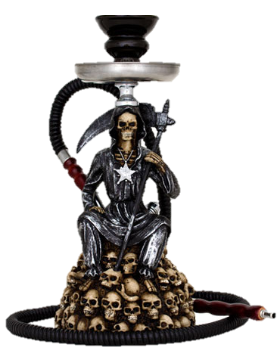
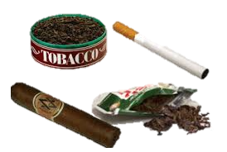

TOBACCO USE 300
What are different types of tobacco products?
HOME

Slide 11
TOBACCO USE 400
NOPE
Is vaping better for you than smoking?
HOME

Slide 12
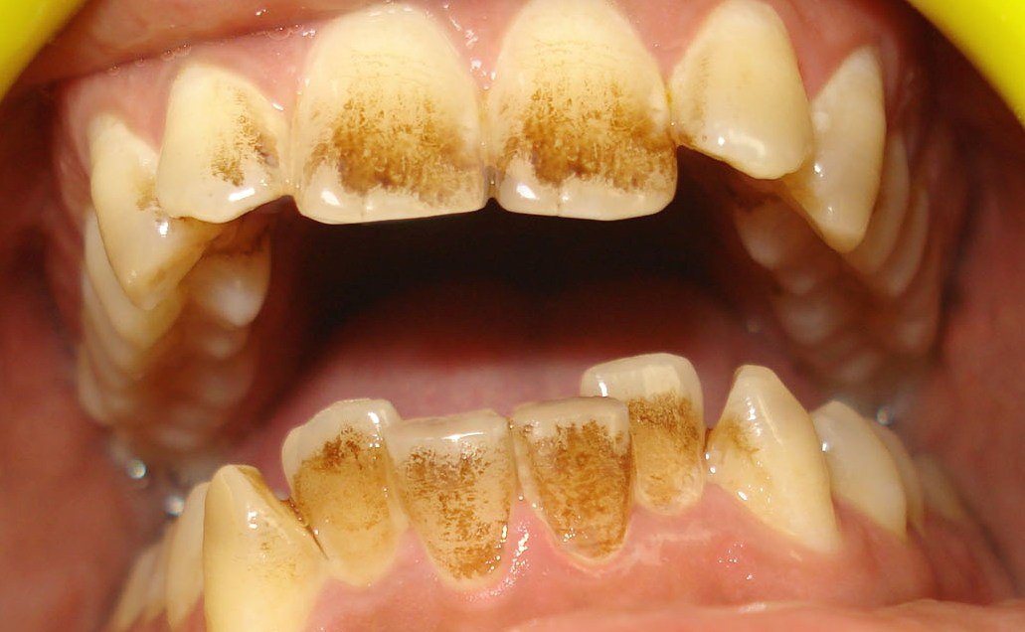
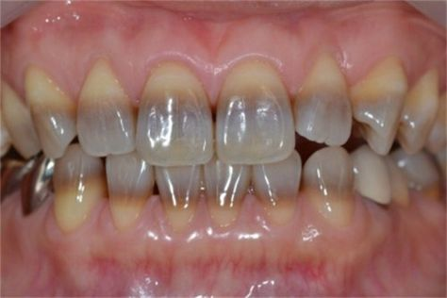
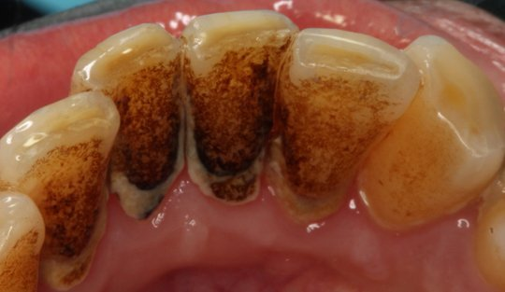
TOBACCO USE 500
Which one of these is a tobacco stain?
HOME

Slide 13
HOME CARE 500
IT PREVENTS BAD BREATH
Why do you need to brush your tongue?
HOME

Slide 14
ORAL HYGIENE INSTRUCTION
Notes:
ADD to ppt and save on jumpdrive!

Slide 15
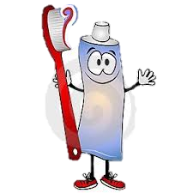
Toothpastes
ADA-Accepted fluoride toothpastes help prevent and reduce
  Plaque
  Gingivitis
    inflammation of the gums caused by the accumulation of plaque along the gum line
  Cavities
    Recommend brushing two or three times a day to remove plaque biofilm.

Slide 16
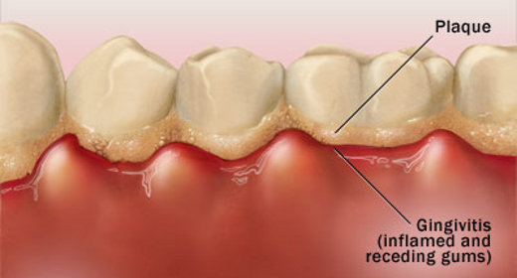
WHAT IS PLAQUE?
Non-mineralized deposits on the surface of the tooth that contain bacteria
It is important to remove this biofilm by brushing 2-3 times daily because if not, the bacteria will continue to multiply.
If not removed, the bacteria will cause inflammation in the tissues and can progress to effect the entire mouth.

Slide 17
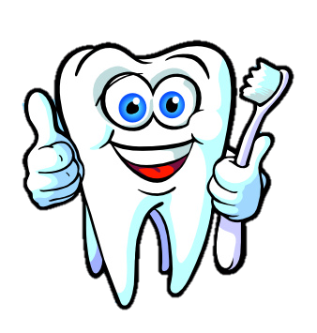
TOOTHBRUSH
An ADA-Accepted soft bristled toothbrush allows you to reach every surface of each tooth.
Replace your toothbrush every three months.
If the bristles on your toothbrush are bent or frayed, buy a new one.
A worn-out brush will not clean your teeth properly.
Soft bristled toothbrush recommended.

Slide 18

HOW LONG SHOULD YOU BRUSH?
Divide the mouth into 4 sections (upper 2, lower2)
Brush each section for 30 seconds
Make sure to brush all surfaces of each tooth

Slide 19
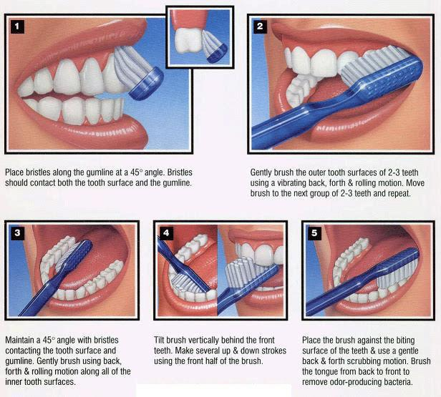

Slide 20
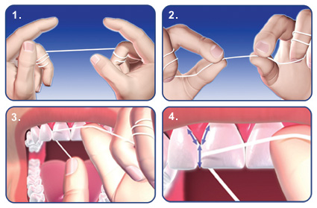
FLOSSING TECHNIQUE

Slide 21

YOUR TURN TO SHOW US!

Slide 22
TOBACCO USE

Slide 23


Slide 24
DIFFERENT TYPES OF TOBACCO
Cigarettes
Smokeless Tobacco
Marijuana
E-Cigarettes
Hookah

Slide 25
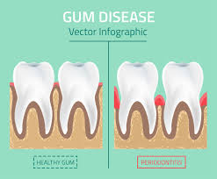
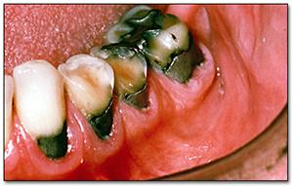
REASONS TO AVOID SMOKING:
Smoking tobacco can cause gum disease.
Tooth decay
Bone loss
Tooth loss
Oral Cancer

Slide 26
Kissing a smoker is like licking an ashtray.
The JUUL does not make you CUUL.
Be smart. Don’t Start.
Girls don’t dig the cig.

Slide 27
RESOURCES
https://odha.on.ca/wp-content/uploads/2016/08/Oral-Cancer-Self-Exam14-1-final.pdf
https://www.quitdoc.com/smokeless-tobacco.html
Kelley, Thomas C., DDS. "Patient Oral Hygiene Instructions." Patient Oral Hygiene Instructions. N.p., n.d. Web. 05 June 2013.
Wilkins, Esther M., and Charlotte J. Wyche. "27: Oral Infection Control: Toothbrushes and Toothbrushing." Clinical Practice of the Dental Hygienist. Philadelphia: Wolters Kluwer Health/Lippincott Williams & Wilkins, 2013. 391-404. Print.

